Slide 1
API and WEB SCRAPING
DATA COLLECTION AND DATA PROCESSING
“The streets of the Web are paved with data that can’t wait to be collected.”
Munzart, Rubba, Meissner, Nyhuis, Automated Data Collection with R

Slide 2
World Wide Web
There was a time in the recent past where both scarcity and inaccessibility of data was a problem for researchers and decision-makers. That is emphatically not the case anymore.
Data abundance carries its own set of problems:
tangled masses of data
traditional data collection methods and classical (small) data analysis techniques may not be sufficient anymore

Slide 3
Web Data Scrapping Example – New Phone
Let’s say you want to know what people think of a new phone. Standard approach: market research (e.g. telephone survey, reward system, etc.)
Pitfalls:
unrepresentative sample: the selected sample might not represent the intended population
systematic non-response: people who don’t like phone surveys might be less (or more) likely to dislike the new phone
coverage error: people without a landline can’t be reached, say
measurement error: are the survey questions providing suitable info for the problem at hand?

Slide 4
Web Data Quality – New Phone
These solutions can be costly, time-consuming, ineffective.
Proxies – indicators that are strongly related to the product’s popularity, without measuring it directly.
If popularity is defined as large groups of people preferring one product over a competitor, then sales statistics on a commercial website may provide a proxy for popularity.
Rankings on Amazon could provide a more comprehensive view of the phone market vs. traditional survey.

Slide 5
Potential Issues – New Phone
Representativeness of the listed products
Are all phones listed?
If not, is it because that website doesn’t sell them?
Is there some other reason?
Representativeness of the customers
Are there specific groups buying/not-buying online products?
Are there specific groups buying from specific sites?
Are there specific groups leaving/not-leaving reviews?
Truthfulness of customers and reliability of reviews.

Slide 6
Is Web Scraping Legal?
What is a spider?
Programs that graze or crawl the web for information rapidly
Jumps from one page to another, grabbing the entire page content
Scraping is taking specific information from specific websites (which is the goal): how are these different?
“Scraping inherently involves copying, and therefore one of the most obvious claims against scrapers is copyright infringement.”

Slide 7
Legal Cases – Web Scraping
eBay vs. Bidder’s Edge (BE)
BE used automated programs to crawl information from different auction sites.
Users could search listings on the BE webpage instead of going to individual auction sites.
BE accessed eBay’s sites ~100 000 times / day (1.53% of # of requests, 1.1% of total data transferred by eBay) in 1999.
eBay alleged damages of up to $45k- $62K in a 10 month period.
BE didn’t steal information that wasn’t public, but excessive traffic was demanding on eBay’s servers.
Your verdict?

Slide 8
Friendly Cooperation with APIs
What is an API? API stands for application program interface which is a set of routines, protocols and tools for building software applications.
Many APIs restrict the user to a certain amount of API calls per day (or some other limits).
These limits should be obeyed.

Slide 9
Supplemental Material

Slide 10
Why Automated Data Collection?
With regards to social scientific data:
sparse financial resources
little time or desire to collect data by hand
want to work with up to date, high quality data rich sources
document process from beginning (data collection) to end (publication) so it can be reproduced
Issues with manual collection:
non-reproducible process
prone to errors and cumbersome
subject to heightened risks of “death by boredom”

Slide 11
Why Automated Data Collection?
Advantages of program-based solutions:
reliability
reproducibility
time-efficient
assembly of higher quality datasets

Slide 12
Automated Collection Checklist
Is web scraping or statistical text processing (automated or semi-automated data collection) really necessary?
Criteria:
Do you plan to repeat the task from time to time e.g. to update your database?
Do you want others to be able to replicate your data collection process?
Do you deal with online sources of data frequently?
Is the task non-trivial in terms of scope and complexity?

Slide 13
Automated Collection Checklist
Criteria: (continued)
If the task can be done manually, do you lack the resources to let others do the work?
Are you willing to automate the process by means of programming?
If most of the answers are positive then an automated approach may be the right choice.

Slide 14
World Wide Web
The way we share, collect, and publish data has changed over the past few years due to the ubiquity of the World Wide Web (WWW).
Private businesses, government, and individual users are posting and sharing all kinds of data and information.
At every moment, new channels generate vast amounts of data on human behaviour.

Slide 15
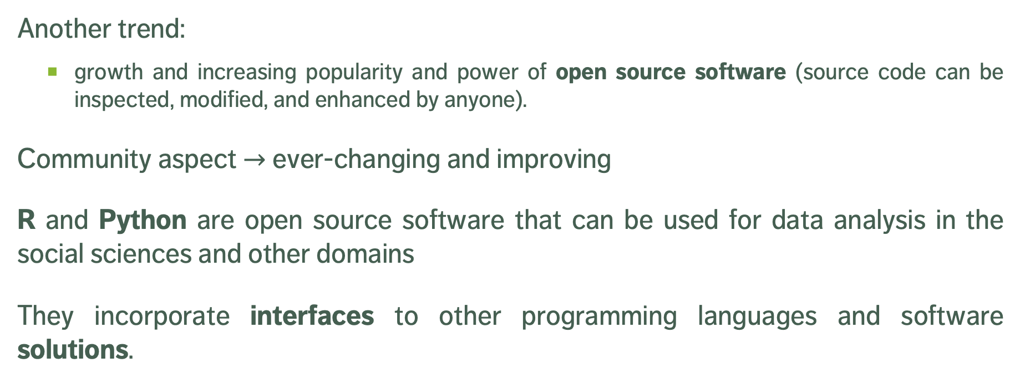
Open Source Software
Another trend:
growth and increasing popularity and power of open source software (source code can be inspected, modified, and enhanced by anyone).
Community aspect $→$ ever-changing and improving
R and Python are open source software that can be used for data analysis in the social sciences and other domains
They incorporate interfaces to other programming languages and software solutions.

Slide 16
Data Cleaning and Data Processing
Data collection proper is only the tip of the iceberg.
Data cleaning and data processing is essential (as well as time-consuming).
Tasks:
Selecting the columns (variables) of interest
Re-labeling these columns
Modifying the data type of the columns so that the data can be used the way we want

Slide 17
Data Cleaning and Data Processing
Tasks: (continued)
Editing and/or extracting data in a column
Deciding how to deal with missing data (which can be a challenge)
Multiple other tasks, depending on the data and its uses
Certain tasks can be automated, others cannot.

Slide 18
Questions About Data Quality
What type of data is most suited to answer your questions?
Is the quality of the data sufficiently high to answer your question?
Is the information systematically flawed?
______________________
Can you avoid the dreaded: “well, it’s the best data we have...”?

Slide 19
Data Quality
First-hand information: for example, a tweet, or a news article
Second-hand data: data that has been copied from an offline source or scraped from elsewhere.
Sometimes you can’t remember or retrace the source of data when it is second-hand.
Does it still make sense to use it? It depends.
Cross-validation is standard for use of any secondary data.

Slide 20
Data Quality and User’s Purpose
Data quality depends on the application.
For example,
Sample of tweets collected on a random day could be used to analyze the use of a hashtags or the gender-specific use of words
Not as useful if collected on Election Day to predict the election outcomes (collection bias)

Slide 21
Data Sources (Trade-Offs)
Automated vs. Traditional
Accuracy vs. Completeness
Coverage vs. Validity
Speed vs. Cost
etc.

Slide 22
Data Collection Process (5 Steps)
1. Know exactly what kind of information you need
Specific: GDP of all OECD countries for last 10 years; sales of top 10 shoe brands in 2017
Vague: people’s opinion on shoe brand X
2. Find out if there are any web data sources that could provide direct or indirect information on your problem
Easier for specific facts: shoe store’s webpage will provide information about shoes that are currently in demand i.e. sandals, boots, etc.
Tweets may contain opinion trends on anything
Commercial platforms can provide information on product satisfaction

Slide 23
Data Collection Process (5 Steps)
3. Develop a theory of the data generation process when looking into potential sources
When was the data generated?
When was it uploaded to the Web?
Who uploaded the data?
Are there any potential areas that are not covered? consistent? accurate?
How often is the data updated?

Slide 24
Data Collection Process (5 Steps)
4. Balance advantages and disadvantages of potential data sources
Validate the quality of data used
Are there other independent sources that provide similar information to crosscheck against
Can you identify original source of secondary data
5. Make a decision
Choose data source that seems most suitable
Document reasons for this decision
Collect data from several sources to validate data sources

Slide 25
Is Web Scraping Legal?
Ethical Guidelines:
Work as transparently as possible
Document data sources at all time
Give credit to those who originally collected and published the data
If you did not collect the information, you probably need permission to reproduce it
Don’t do anything illegal.
Crawling another company’s information to process and resell it is a common complaint.

Slide 26
Legal Cases – Web Scraping
Associated Press (AP) vs. Meltwater
Meltwater offers software that scrapes news information based on specific keywords.
Clients order summaries on topics containing excerpts of news articles.
AP said their content was stolen and that Meltwater needed a license before distributing the information that was scraped.
The judge found in favour of AP arguing that Meltwater is a competitor.
Your verdict?

Slide 27
Legal Cases – Web Scraping
Facebook vs. Pete Warden
Pete Warden scraped basic information from Facebook users’ profiles, to offer services to manage communication and networks.
His process, according to him, was in line with robots.txt.
After his first blog post using the data he scraped from Facebook, he was asked to delete the data.
Facebook contends that robots.txt has no legal force and they could sue anyone for accessing their site even if they complied with the scraping instructions, that the only legal way to access any website with a crawler was to obtain prior written permission.
Your verdict?

Slide 28
Legal Cases – Web Scraping
United States vs Aaron Swartz
Swartz co-created RSS, markdown and Infogami.
He was arrested in 2011 for having illegally downloaded millions of articles from the archives of JSTOR.
The case was dismissed after his suicide in January 2013.
Your verdict?

Slide 29
Lessons Learned
Not clear which scraping actions are illegal and which are legal.
Re-publishing content for commercial purposes is considered more problematic than downloading pages for research/analysis.
Robots.txt: Robots Exclusion Protocol is a file that tells scrapers what information on the site may be harvested.
Be friendly! Not everything that can be scraped requires to be scraped. Scraping programs should behave “nicely”, provide the data you seek, and be efficient, in this order.

Slide 30
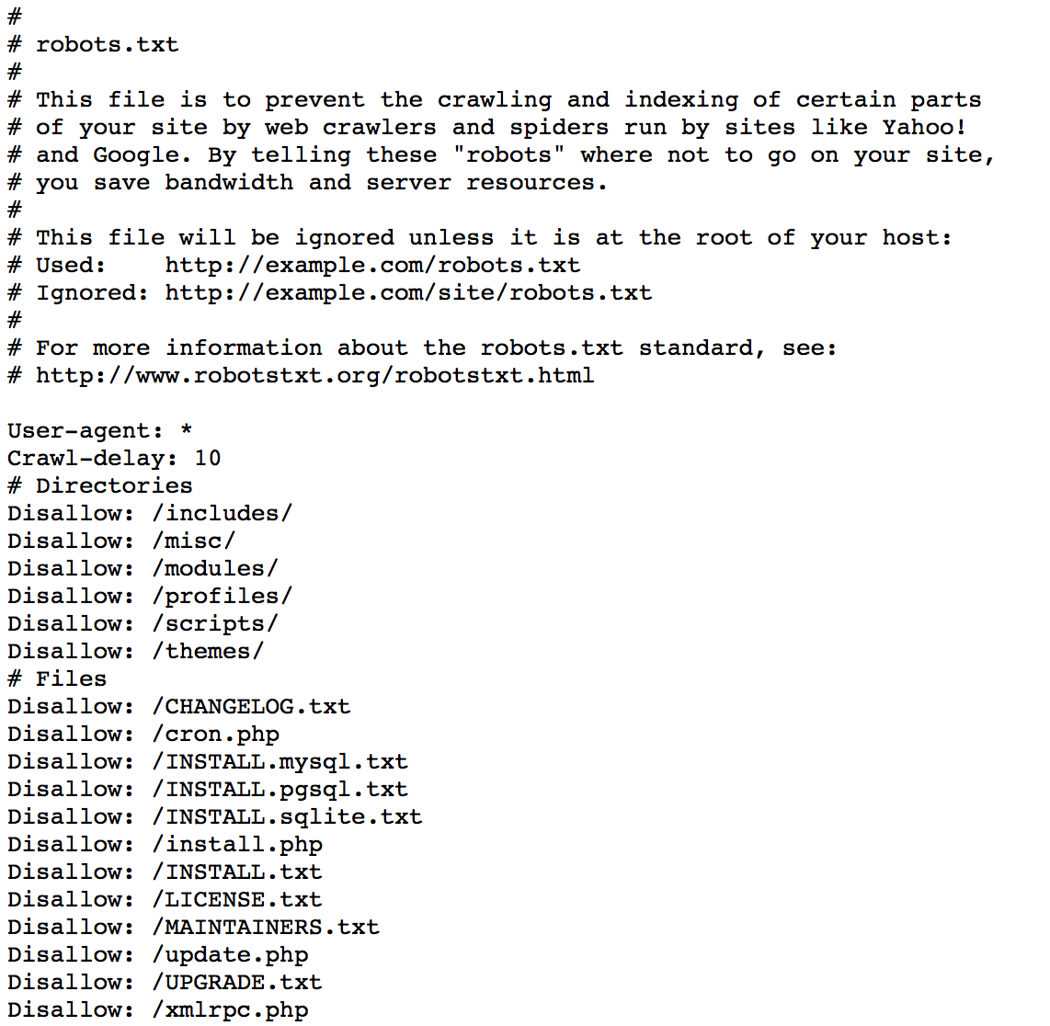
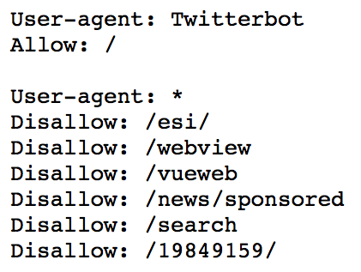
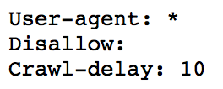
cqads.carleton.ca/robots.txt
theweathernetwork.com/robots.txt
cfl.ca/robots.txt

Slide 31
Contact Data Providers
Any data accessed by HTTP forms is stored in some sort of database.
Ask proprietors of the data first if they will grant access to the database or files.
The larger the amount of data you want, the better it is for both parties to communicate before starting to harvest data.
For small amounts of data, that’s less important.

Slide 32
Scraping Do’s and Don’t’s
1. Stay identifiable
2. Reduce traffic
Accept compressed files
If scraping the same resources multiple times, check first if it has changed before accessing again
Retrieve only parts of a file

Slide 33
Scraping Do’s and Don’t’s
3. Do not bother server with multiple requests
Many requests per second can bring smaller servers down
Webmasters may block you if your scraper behaves this way
One or two request per second is fine
4. Write modest scraper (efficient and polite)
No reason to scrape pages daily or repeat same task over and over; make your scraper as efficient as possible
Do not over-scrape pages
Select resources you want to use and leave the rest untouched

Slide 34
Developer Tools
Developer tools allow us (among other things) to see the correspondence between the HTML code for a page, and the rendered version we see in the browser.
Unlike “View Source”, developer tools shows the dynamic version of the HTML (i.e. the HTML is shown with any changes made by JavaScript since the page was first received).
Inspecting a page’s various elements and discovering where they reside in the HTML file is crucial to efficient web scraping.

Slide 35
Developer Tools
Firefox
right click page → Inspect Element
Safari
Safari → Preferences → Advanced → Show Develop Menu in Menu Bar
Develop → Show Web Inspector
Chrome
right click page → Inspect

Slide 36
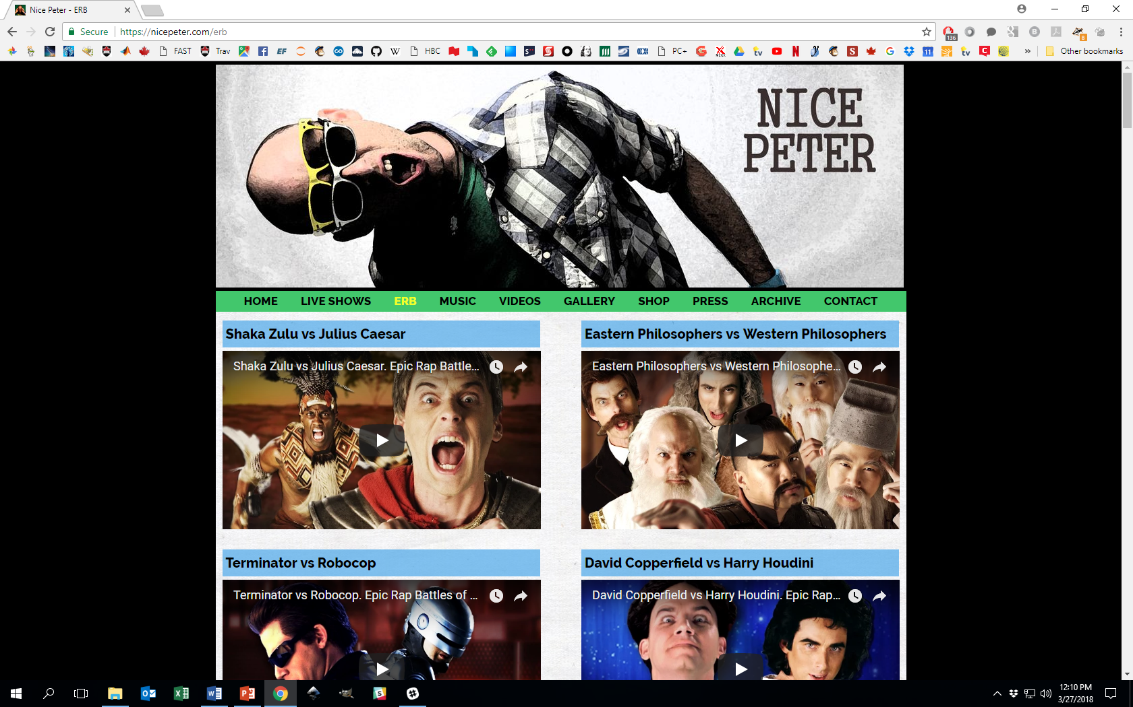

Slide 37
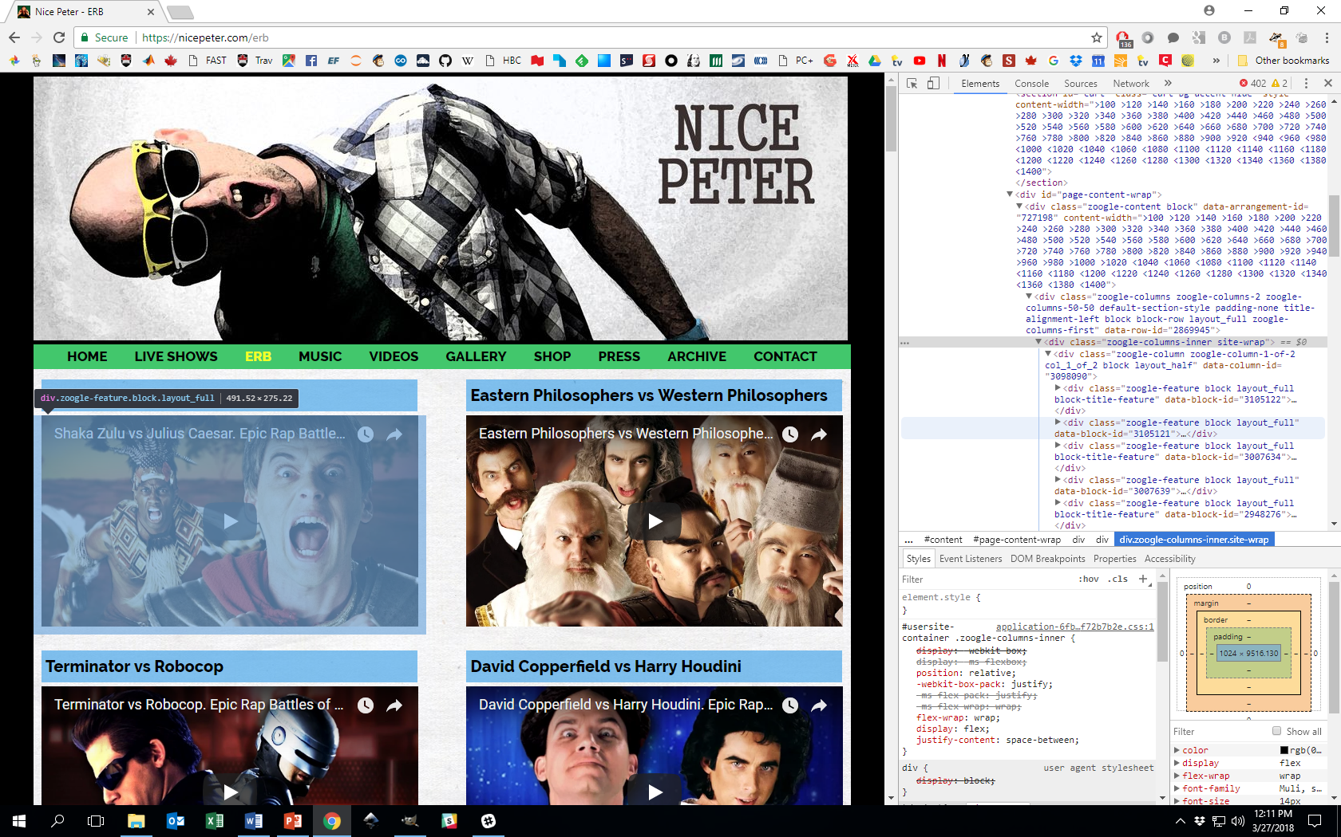

Slide 38
XPath
XPath is a query (domain-specific) language
Used to select specific pieces of information from marked-up documents such as HTML, XML or variants such as SVG, RSS
Information stored in marked-up documents needs to be converted into formats suitable for processing and statistical analysis
Implemented in R package XML
Process steps:
1. Specifying the data of interest
2. Locating it in a specific document
3. Tailoring a query to the document to extract the desired info.

Slide 39
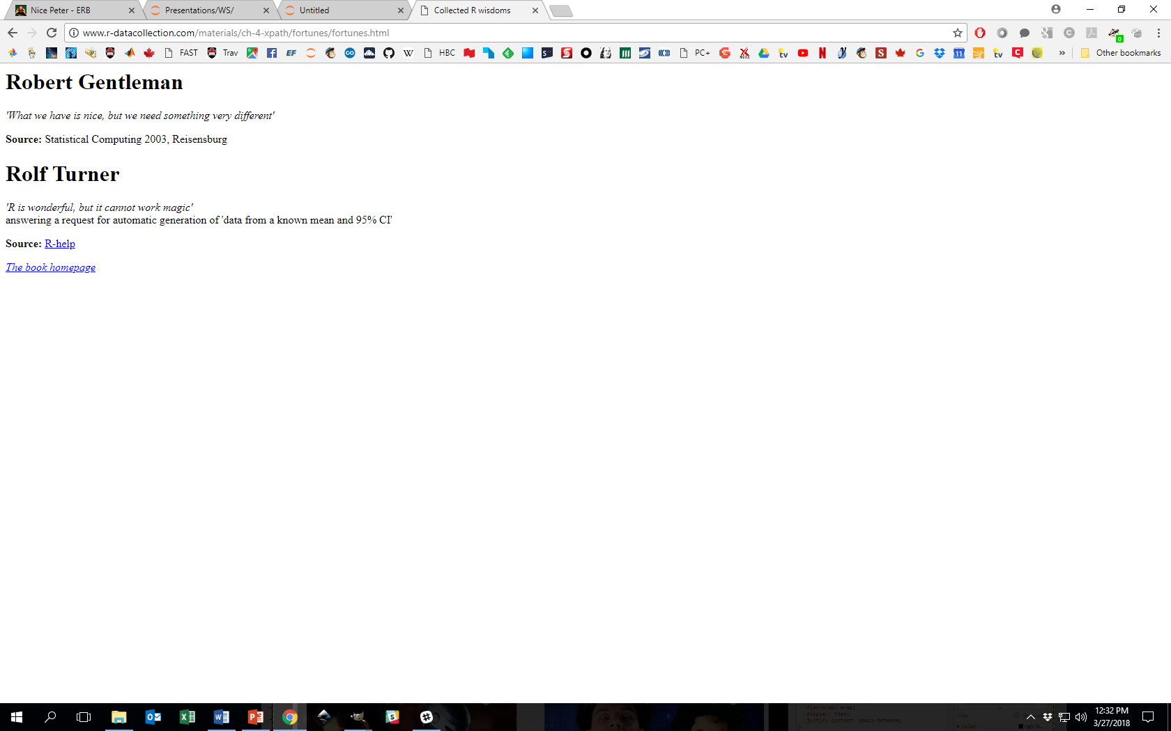
[Automated Data Collection with R]
Notebook: XPath Basics

Slide 40
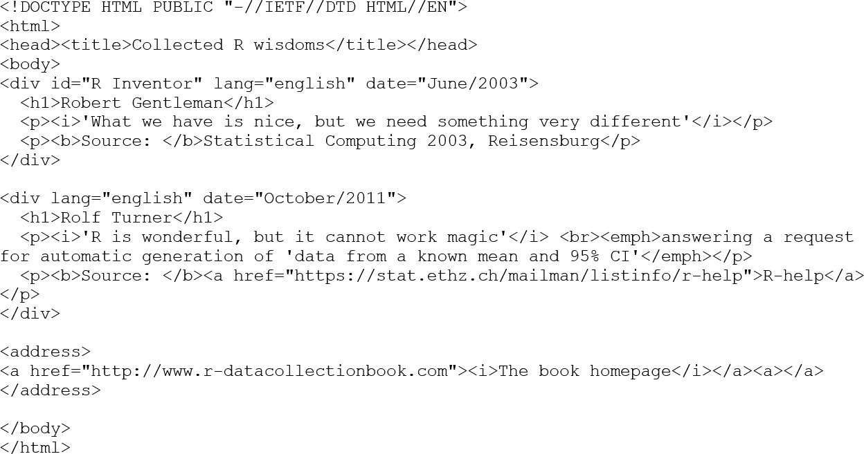
[Parsed HTML file, Automated Data Collection with R]

Slide 41
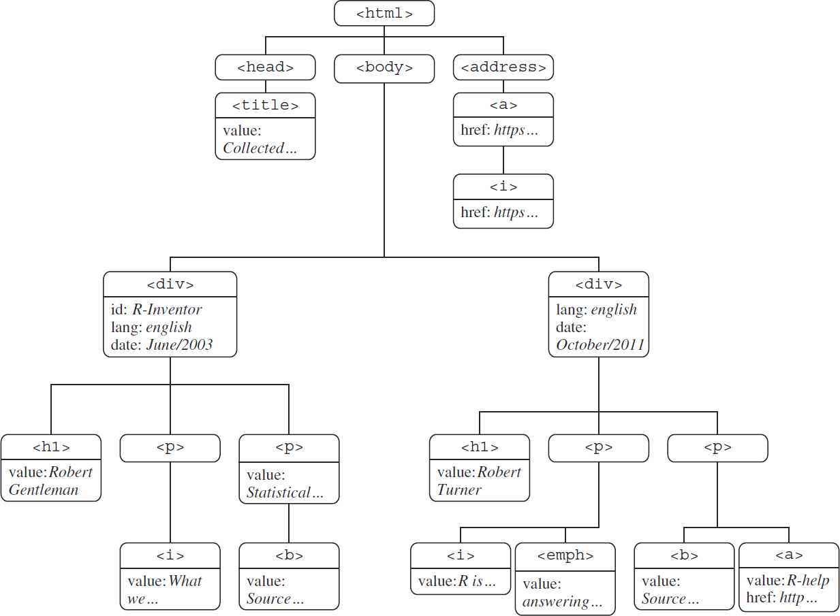
[Parsed tree, Automated Data Collection with R]

Slide 42
XPath – Basic Structure
HTML/XML tags have attributes and values.
HTML files must be parsed before they can be queried by XPath.
XPath queries require a path and a document to search.
paths consist of hierarchical addressing mechanism (succession of nodes, separated by forward slashes [“/”])
a query takes the form xpathSApply(doc,path):
xpathSApply(parsed_doc,"/html/body/div/p/i")
would find all <i> tags inside a <p> tag inside a <div> tag in the body of the html file.

Slide 43
XPath – Node Relations
Absolute (or even relative) paths cannot always succinctly select nodes in large or complicated files.
Family tree analogy: nodes’ placement in the parsed tree often mimic the relations in extended families.
Relations are denoted according to node1/relation::node2.
Examples:
"//a/ancestor::div" returns all <div> nodes that are ancestor to an <a> node.
"//a/ancestor::div//i" returns all <i> nodes contained in a <div> node that is an ancestor to an <a> node, etc.

Slide 44
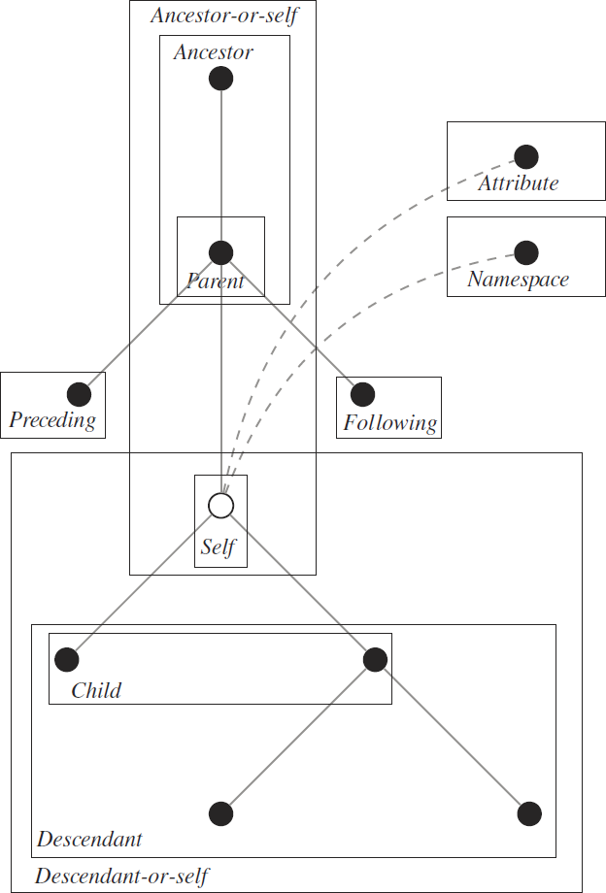
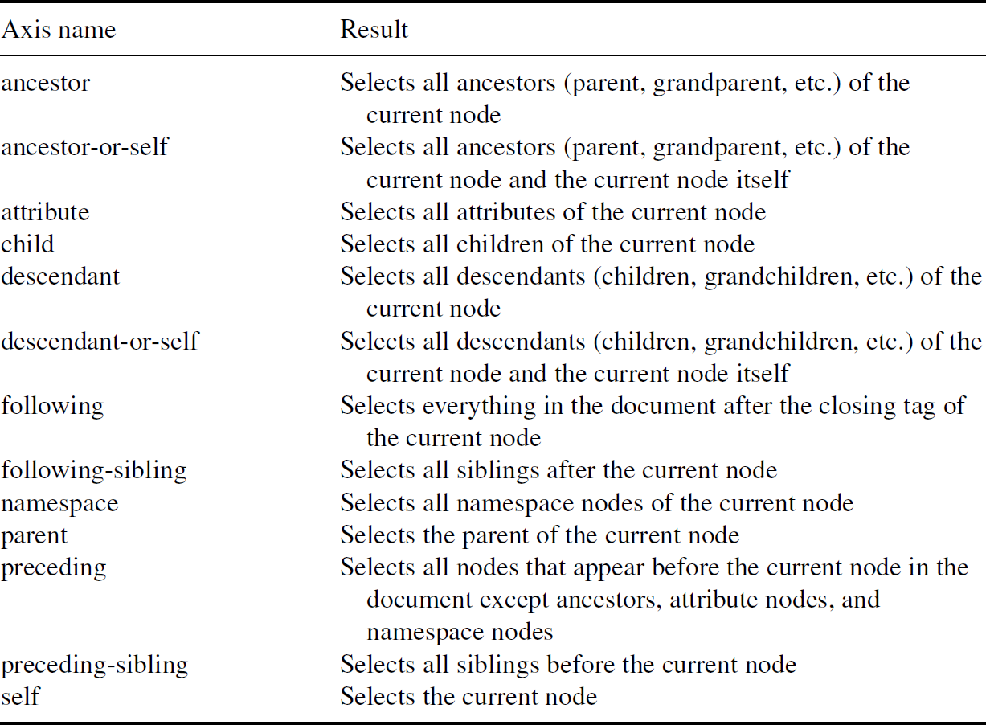
[Node relations, Automated Data Collection with R]

Slide 45
XPath – Predicates
A predicate is a function that applies to a node’s name, value, or attributes and that returns a logical TRUE or FALSE.
Predicates modify the path input of an XPath query. Nodes for which the relation is true are selected by the query.
Predicates are denoted by square brackets, placed after a node.
Examples:
"//p[position()=1]" returns the first <p> node relative to its parent node
"//p[last()]" returns the last <p> node relative to its parent node
"//div[count(./@*)>2]" returns all <div> nodes with 2+ attributes, etc.

Slide 46
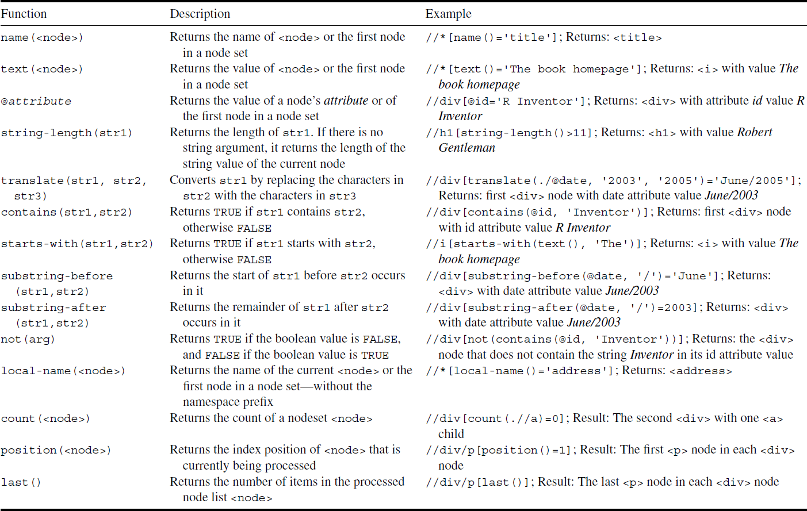
[Important XPath functions, Automated Data Collection with R]

Slide 47
UK Gov Press Releases – Background
The United Kingdom Government publishes all of its press releases online, at gov.uk/government/announcements.
As of 29 March 2018, there were 65K+ press releases available on the site.
Questions:
Can we predict which agency released an announcement based on its textual content alone?
Are there topics that seem to return to the forefront over and over?
[Automated Data Collection with R]

Slide 48
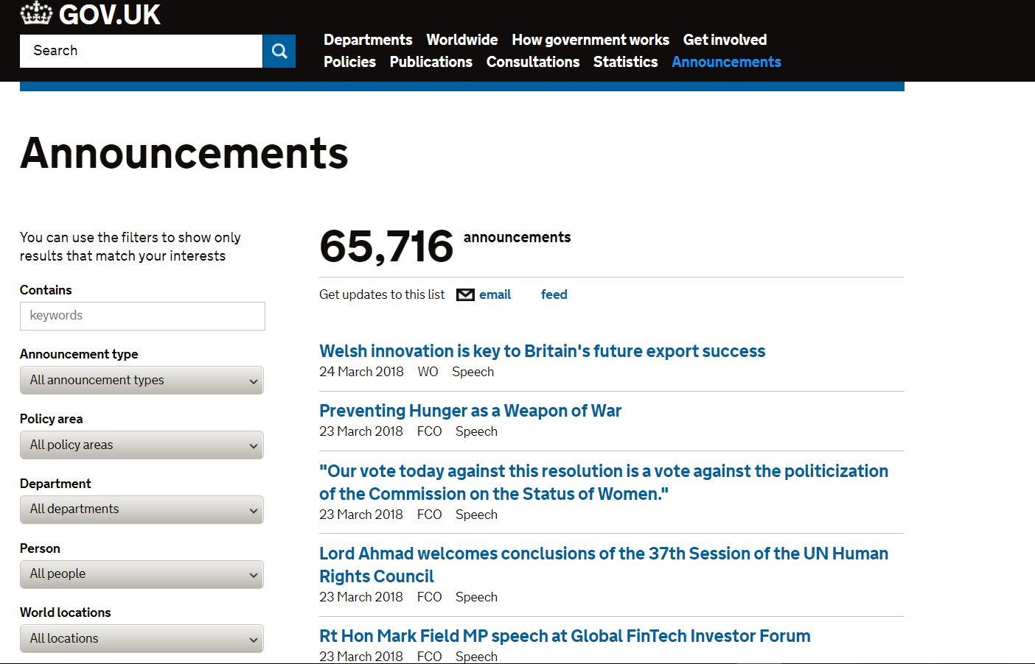

Slide 49
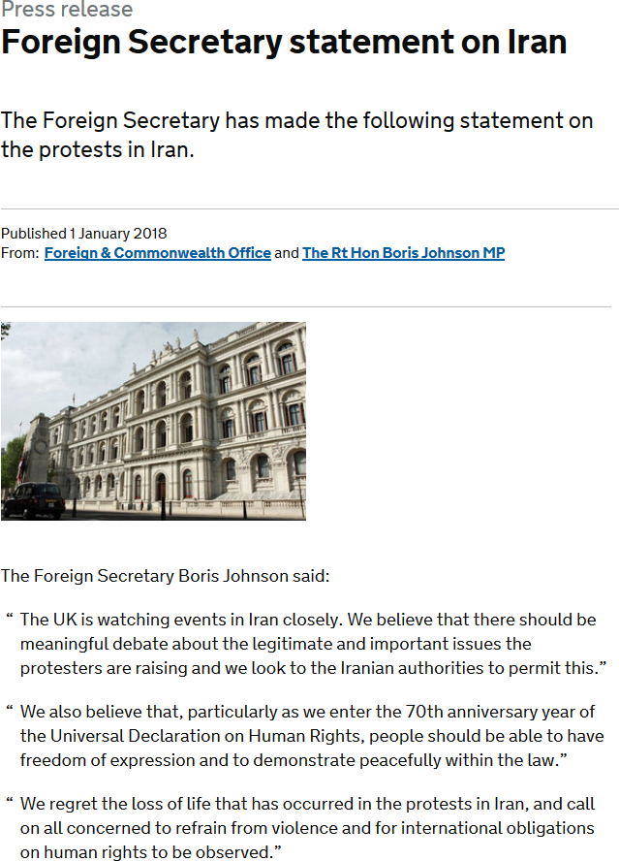
Individual press releases contain:
title
date of publication
publishing organisations/individuals
text of the release
Focus on 2017, and releases from
Wales Office
Foreign Office
Department of Science and Technology
Department for Environment, Food & Rural Affairs
_______________________________________________________
Notebook: UK Gov Press Releases

Slide 50
Regular Expressions
Main task in web scraping is to collect relevant information for the research problem from lots of textual data.
We care about systematic elements of textual data, especially if quantitative methods are eventually going to be applied.
Systematic structures can be
numbers
names (countries, etc.)
addresses (mailing, e-mailing, URLs, etc.)
specific character strings, etc.

Slide 51
Regular Expressions
Regular expressions (regexps) allow for the systematic extraction of the information components.
Regexps are abstract sequences of strings that match concrete recurring patterns in text.
Can be used to extract from plain text, HTML, and XML.
Useful when information is hidden within atomic values.
________________________
Notebook: Python Regular Expressions and More

Slide 52
Beautiful Soup
Simple web requests require some networking code to fetch a page and return the HTML contents.
Browsers do a lot of work to intelligently parse totally improper HTML syntax, something like:
<a href="crummy.com> <b>link text<a> </b>
Beautiful Soup is a Python library that helps extract data out of HTML and XML files. It parses HTML files, even if they’re broken.

Slide 53
Beautiful Soup
BS does not simply convert bad HTML to good XHTML, to be parsed with an XML parser.
BS allows a user to fully inspect the (proper) HTML structure it produces, programmatically.
When BS is done its work on an HTML file, the result is an API for traversing, searching, and reading the document’s elements.

Slide 54
Beautiful Soup
Typical HTML elements to be extracted/read come in various formats:
text
tables
form field values
images
videos
etc.
It provides idiomatic ways of navigating, searching, modifying the parse tree of the HTML file (it’s a huge time-saver).

Slide 55
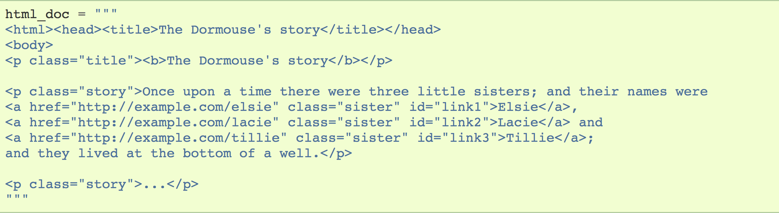
[Beautiful Soup documentation, https://www.crummy.com/software/BeautifulSoup/bs4/doc/]

Slide 56
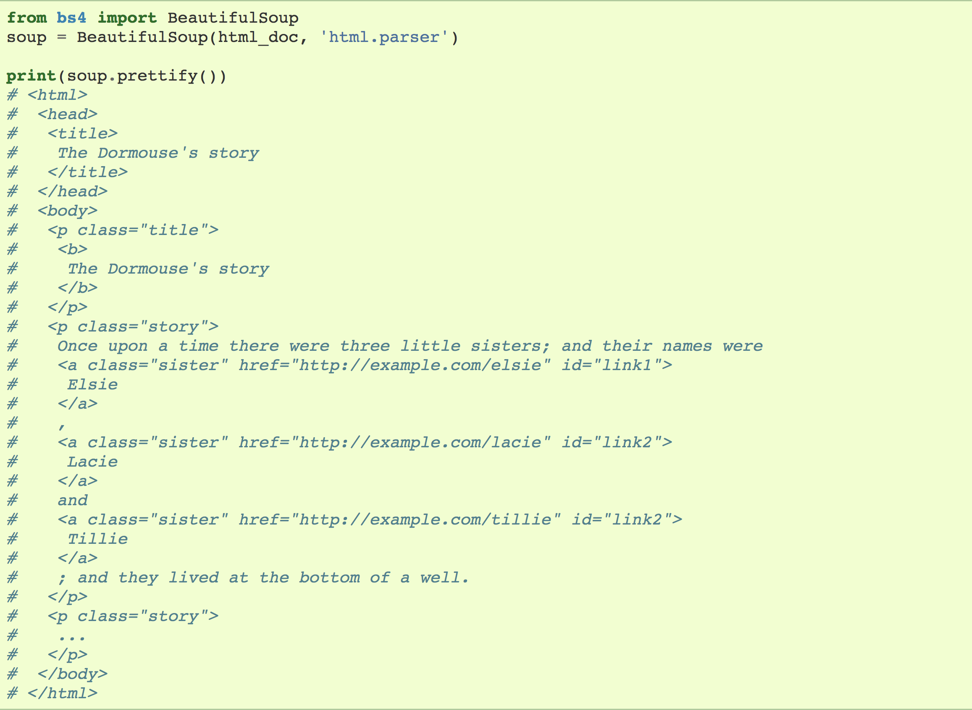
[Beautiful Soup documentation, https://www.crummy.com/software/BeautifulSoup/bs4/doc/]

Slide 57
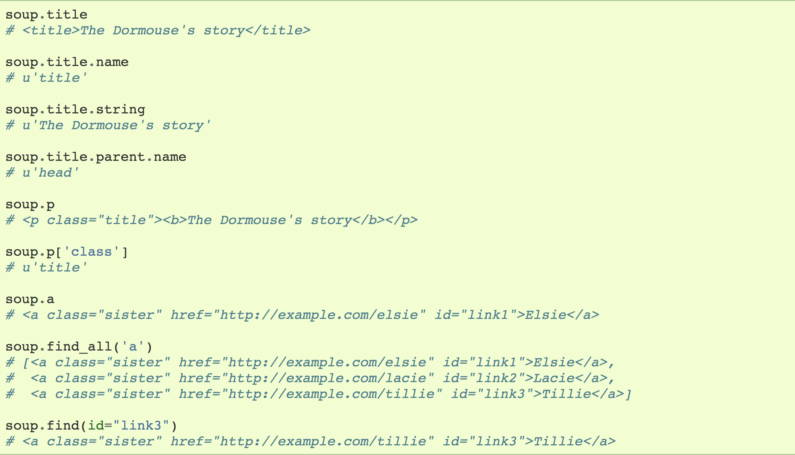
[Beautiful Soup documentation, https://www.crummy.com/software/BeautifulSoup/bs4/doc/]

Slide 58
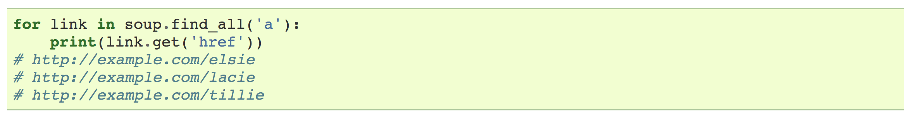
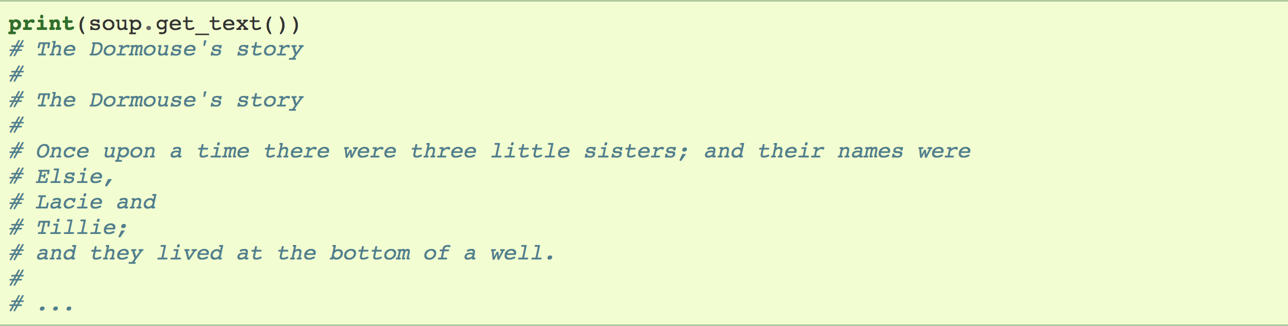
[Beautiful Soup documentation, https://www.crummy.com/software/BeautifulSoup/bs4/doc/]

Slide 59
Selenium
[R.Taracha, Introduction to Web Scraping using Selenium]
Selenium is a tool to automate web browser interactions (in Python). It is used primarily for automating web applications for testing purposes, but it has other applications.
Mainly, it allows the user to open a browser and to perform tasks as a human being would, such as:
clicking buttons
entering information in forms
searching for specific information on the web pages
etc.

Slide 60
Selenium
Selenium requires a driver to interface with the chosen browser. Firefox, for example, requires geckodriver.
Other supported browsers will have their own drivers available:
Chrome: | https://sites.google.com/a/chromium.org/chromedriver/downloads
Edge: | https://developer.microsoft.com/en-us/microsoft-edge/tools/webdriver/
Firefox: | https://github.com/mozilla/geckodriver/releases
Safari: | https://webkit.org/blog/6900/webdriver-support-in-safari-10/

Slide 61
Simulating a Web Browser
Selenium automatically controls a complete browser, including rendering the web documents and running JavaScript.
This is useful for pages with a lot of dynamic content that isn't in the base HTML.
Selenium can program actions like "click on this button", or "type this text", and at any point you have access to the dynamic HTML of the current state of the page, like what you see in Developer Tools.

Slide 62
Using APIs
An API is a website's way of giving programs access to their data, without the need for scraping.
That is, an API provides structured access to structured data.
For example, a finance site might offer an API with financial data, or the New York Times might offer an API for news articles.
In either case, the data will be in a pre-defined, structured format (often JSON).

Slide 63
Using APIs
The APIs we'll consider have R/Python libraries that encapsulate all required networking and encoding.
This means that it suffices to read the library documentation to know what to do.
_________________________________
Exercise: Use Zomato to find which Canadian city has the best sushi restaurants (https://github.com/fatihsucu/pyzomato).

Slide 64
YouTube API – Khan Academy
Millions of videos are available through YouTube.
It’s not obvious how one would scrape video content off the web in general (other than the URLs); some videos have associated text content (transcripts).
We use the YouTube API to scrape that content.
_________________________________________________________
Notebook: YouTube Transcripts

Slide 65
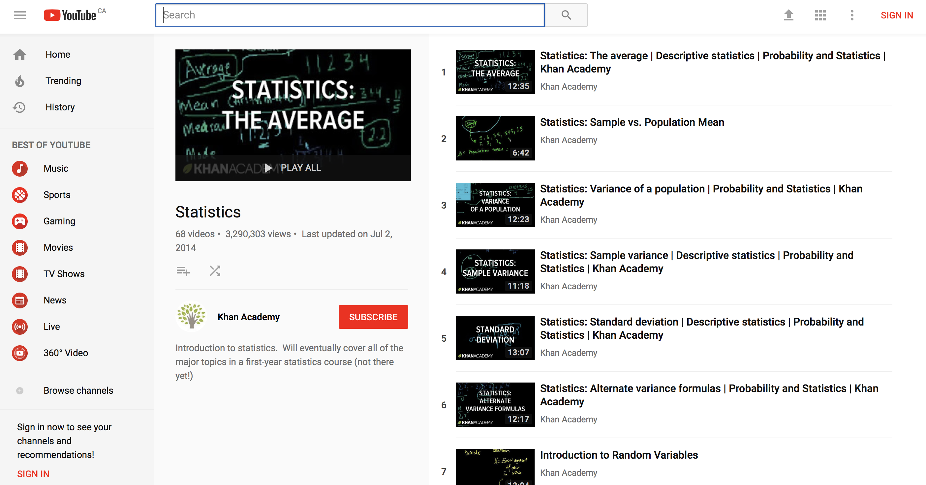
[https://www.youtube.com/playlist?list=PL1328115D3D8A2566]

